Slide 1
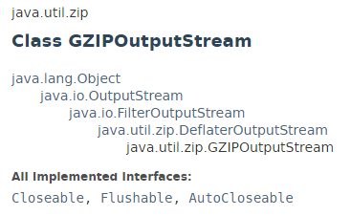
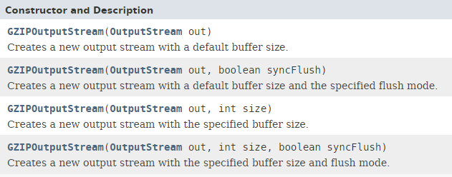
GZIPOutputStream - How to compress a file in GZIP format
Gzip is a popular tool to compress a file in *nix system. However, Gzip is not a ZIP tool, it only use to compress a file into a “.gz” format, not compress several files into a single archive.

Slide 2

GZIPOutputStream - How to compress a file in GZIP format

Slide 3
GZIPOutputStream - How to compress a file in GZIP format
https://docs.oracle.com/javase/8/docs/api/java/util/zip/GZIPOutputStream.html

